Slide 1
Introduction to HTML
Chapter 3

Slide 2
Chapter 3
1
What Is HTML and Where Did It Come from?
2
HTML Syntax
3
Semantic Markup
4
Structure of HTML Documents
5
Quick Tour of HTML Elements
6
HTML5 Semantic Structure Elements
7
Summary

Slide 3
Chapter 3
1
What Is HTML and Where Did It Come from?
2
HTML Syntax
3
Semantic Markup
4
Structure of HTML Documents
5
Quick Tour of HTML Elements
6
HTML5 Semantic Structure Elements
7
Summary

Slide 4
What Is HTML and Where Did It Come from?
HTML
HTML is defined as a markup language.
markup is a way to indicate information about the content that is distinct from the content
HTML has been through many versions and branches, the details of which might matter if you ever see old HTML code.

Slide 5
What Is HTML and Where Did It Come from?
Markup

Slide 6
What Is HTML and Where Did It Come from?
XHTML and Validation

Slide 7
What Is HTML and Where Did It Come from?
HTML 5
Widely implemented in modern browsers
The current W3C recommendation for web development
Still relatively new and not always taught.

Slide 8
Chapter 3
1
What Is HTML and Where Did It Come from?
2
HTML Syntax
3
Semantic Markup
4
Structure of HTML Documents
5
Quick Tour of HTML Elements
6
HTML5 Semantic Structure Elements
7
Summary

Slide 9
HTML Syntax
Elements and Attributes
HTML documents are composed of textual content and HTML elements
HTML element encompasses
the element name within angle brackets (i.e., the tag) and
HTML elements can also contain attributes.
the content within the tag.

Slide 10
HTML Syntax
Elements and Attributes
An empty element does not contain any text content; instead, it is an instruction to the browser to do something.
In XHTML, empty elements had to be terminated by a trailing slash.
In HTML5, the trailing slash in empty elements is optional.

Slide 11
HTML Syntax
Nesting HTML Elements

Slide 12
HTML Syntax
Nesting HTML Elements

Slide 13
HTML Syntax
Nesting HTML Elements

Slide 14
HTML Syntax
Nesting HTML Elements

Slide 15
Chapter 3
1
What Is HTML and Where Did It Come from?
2
HTML Syntax
3
Semantic Markup
4
Structure of HTML Documents
5
Quick Tour of HTML Elements
6
HTML5 Semantic Structure Elements
7
Summary

Slide 16
Semantic Markup
Focus on the structure of the document, not the visual
Advantages:
Maintainability
Performance
Accessibility (http://www.w3.org/WAI )
Search Engine Optimization

Slide 17
Chapter 3
1
What Is HTML and Where Did It Come from?
2
HTML Syntax
3
Semantic Markup
4
Structure of HTML Documents
5
Quick Tour of HTML Elements
6
HTML5 Semantic Structure Elements
7
Summary

Slide 18
Structure of HTML Documents
A simple example

Slide 19
Structure of HTML Documents
DOCTYPE
DOCTYPE Short for Document Type Definition tells the browser what type of document it is about to process
<!DOCTYPE html>

Slide 20
Structure of HTML Documents
A slightly more complex document

Slide 21
Structure of HTML Documents
Head and Body
HTML5 does not require the use of the <html> , <head> , and <body> elements (but most developers continue to use them).
<html> contains all the other HTML elements in the document (Item 2 in previous slide)
<head> contains descriptive elements about the document, such (title, style sheets, JavaScript files etc.) (Item 3)
<body> contains content to be displayed by the browser (Item 4)

Slide 22
Structure of HTML Documents
Some more common elements
The <meta> element (Item 5) declares that the character encoding for the document is UTF-8.
Item 6 specifies an external CSS style sheet file with <link> that is used with this document.
Item 7 references an external JavaScript file using <script>

Slide 23
Chapter 3
1
What Is HTML and Where Did It Come from?
2
HTML Syntax
3
Semantic Markup
4
Structure of HTML Documents
5
Quick Tour of HTML Elements
6
HTML5 Semantic Structure Elements
7
Summary

Slide 24
Quick Tour of HTML Elements
A document to walk through

Slide 25
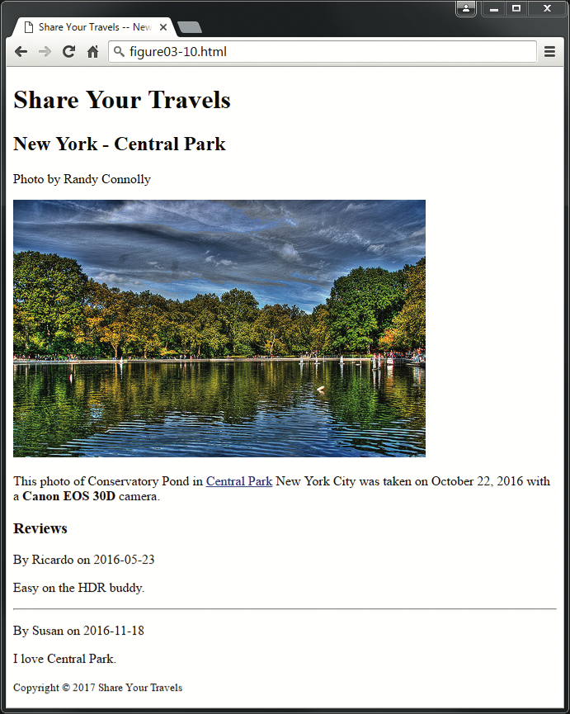
Quick Tour of HTML Elements
A document to walk through

Slide 26
Quick Tour of HTML Elements
CSS styles are coming soon, HTML is structural

Slide 27
Quick Tour of HTML Elements
Headings
HTML provides six levels of heading (h1 - h6)
Headings are also used by the browser to create a document outline for the page.

Slide 28
Quick Tour of HTML Elements
Paragraphs and Divisions
<p> tag is a container for text and other HTML elements
<div> also a container element and is used to create a logical grouping of content

Slide 29
Quick Tour of HTML Elements
Links
Links are an essential feature of all web pages
Links use the <a> element (the “a” stands for anchor).

Slide 30
Quick Tour of HTML Elements
Links

Slide 31
Quick Tour of HTML Elements
Links (continued)

Slide 32
Quick Tour of HTML Elements
URL Relative Referencing
Relative Link Type | Example
Same directory | <a href="example.html">
Child Directory | <a href="images/logo.gif">
Grandchild/Descendant Directory | <a href="css/images/background.gif">
Parent/Ancestor Directory | <a href="../about.html"> <a href="../../about.html”>
Sibling Directory | <a href="../images/about.html">
Root Reference | <a href="/images/background.gif">

Slide 33
Quick Tour of HTML Elements
Inline Text Elements … they do not disrupt the flow
<a>
<abbr>
<br>
<cite>
<code>
<em>
<mark>
<small>
<span>
<strong>
<time>

Slide 34
Quick Tour of HTML Elements
Images

Slide 35
Quick Tour of HTML Elements
Character Entities
These are special characters for symbols for which
there is either no easy way to type them via a keyboard
or which have a reserved meaning in HTML (like“<“)
Entity | Description
&nbsp; | Nonbreakable space
&lt; | <
&gt; | >
&copy; | ©
&trade; | ™

Slide 36
Quick Tour of HTML Elements
Lists
Unordered Lists <ul>
Ordered Lists <ol>
Description Lists <dl>

Slide 37
Quick Tour of HTML Elements
Lists

Slide 38
Chapter 3
1
What Is HTML and Where Did It Come from?
2
HTML Syntax
3
Semantic Markup
4
Structure of HTML Documents
5
Quick Tour of HTML Elements
6
HTML5 Semantic Structure Elements
7
Summary

Slide 39
HTML5 Semantic Structure Elements

Slide 40
HTML5 Semantic Structure Elements
Header and Footer

Slide 41
HTML5 Semantic Structure Elements
Header and Footer
A header element is intended to usually contain the section’s heading (an h1– h6 element), but this is not required.
The header element can also be used to wrap a section’s table of contents, a search form, or any relevant logos.
<header>
<img src="logo.gif" alt="logo" />
<h1>Fundamentals of Web Development</h1>
...
</header>
<article>
<header>
<h2>HTML5 Semantic Structure Elements</h2>
<p> By <em>Randy Connolly</em></p>
</header>
...
</article>

Slide 42
HTML5 Semantic Structure Elements
Navigation
<header>
<img src="logo.gif" alt="logo" />
<h1>Fundamentals of Web Development</h1>
<nav>
<ul>
<li><a href="index.html">Home</a></li>
<li><a href="about.html">About Us</a></li>
<li><a href="browse.html">Browse</a></li>
</ul>
</nav>
</header>

Slide 43
HTML5 Semantic Structure Elements
Main
<main> is meant to contain the main unique content of the document.
<main> provides a semantic replacement for markup such as <div id="main"> or <div id="main-content">

Slide 44
HTML5 Semantic Structure Elements
Articles and Sections
<section> is a much broader element, while the
<article> element is to be used for blocks of content that could potentially be read or consumed independently of the other content on the page

Slide 45
HTML5 Semantic Structure Elements
Figure and Figure Captions

Slide 46
HTML5 Semantic Structure Elements
Aside
The <aside> element can be used for sidebars, pull quotes, groups of advertising images, or any other grouping of nonessential elements

Slide 47
HTML5 Semantic Structure Elements
Details and Summary

Slide 48
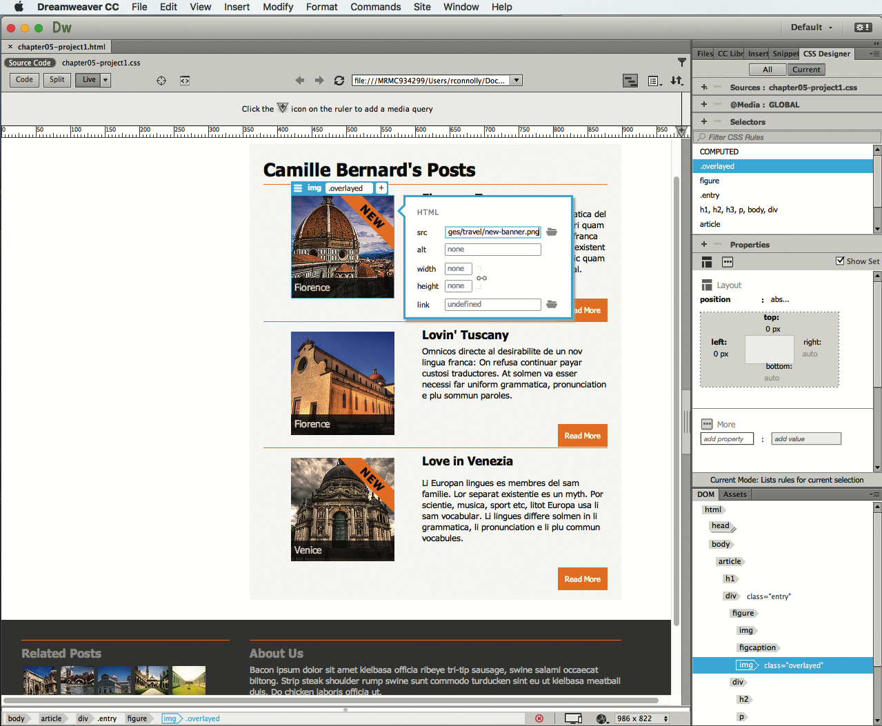
Tools Insight
WYSIWYG Editors

Slide 49
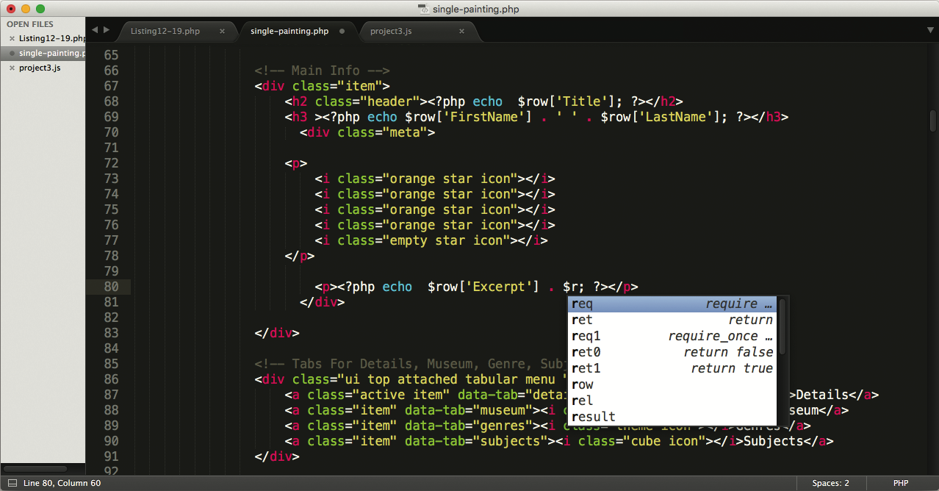
Tools Insight
Code Editors

Slide 50
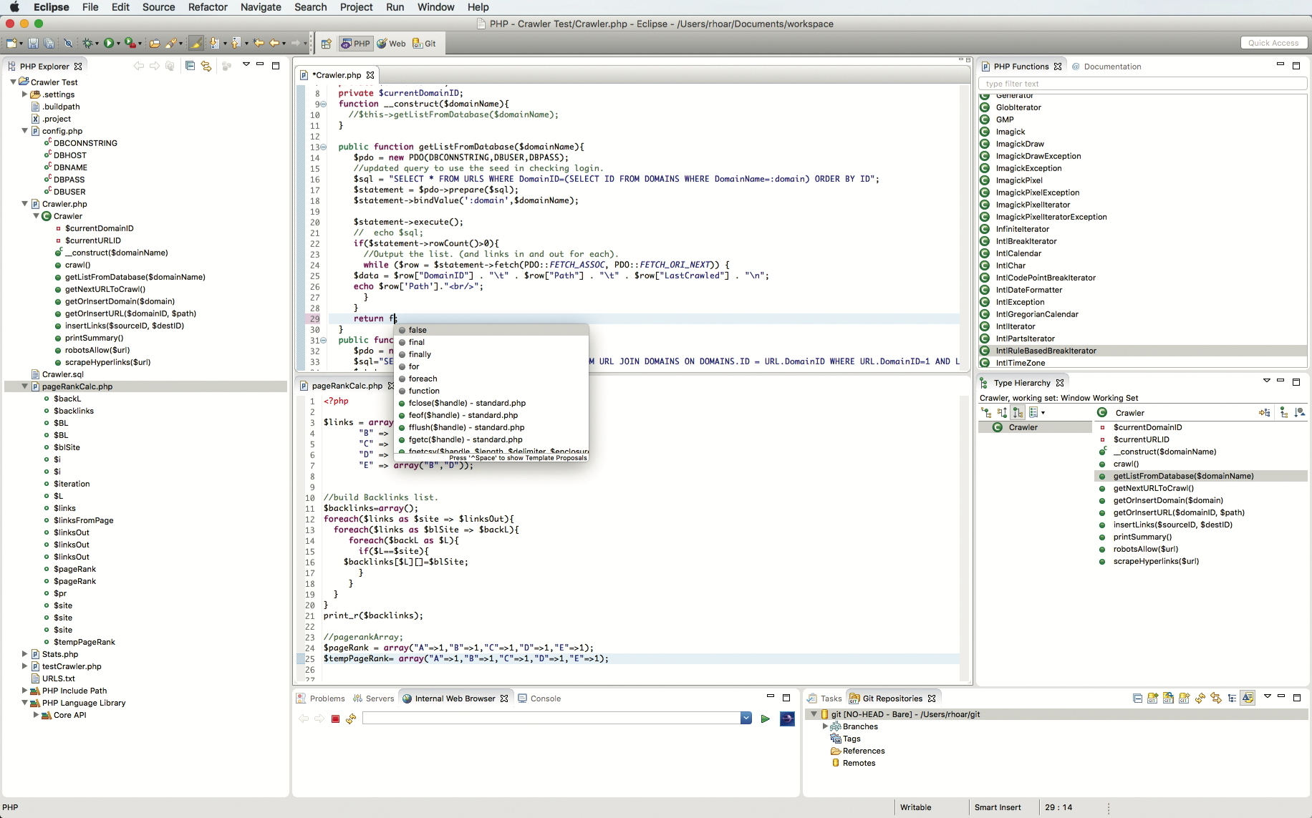
Tools Insight
Integrated Development Environments

Slide 51
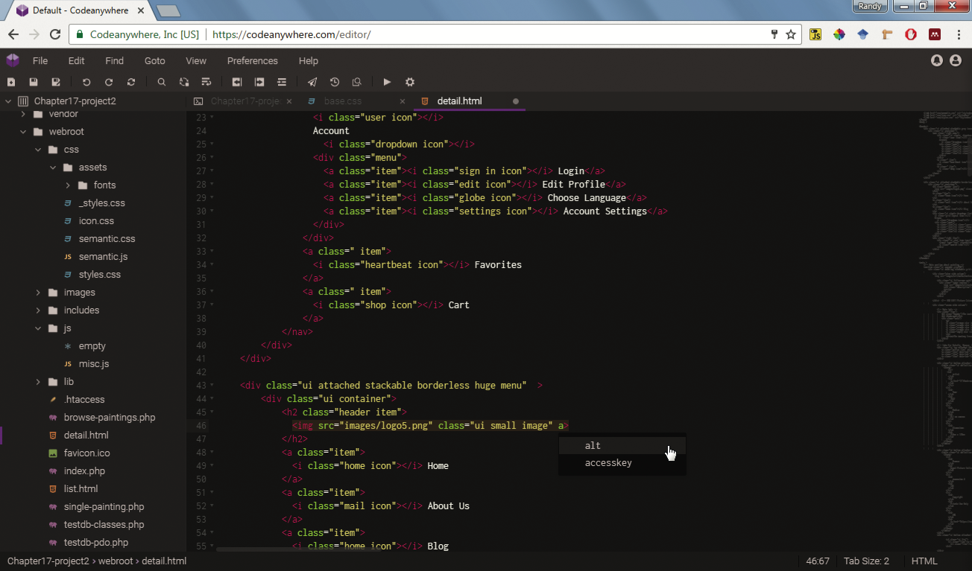
Tools Insight
Cloud-Based Environments

Slide 52
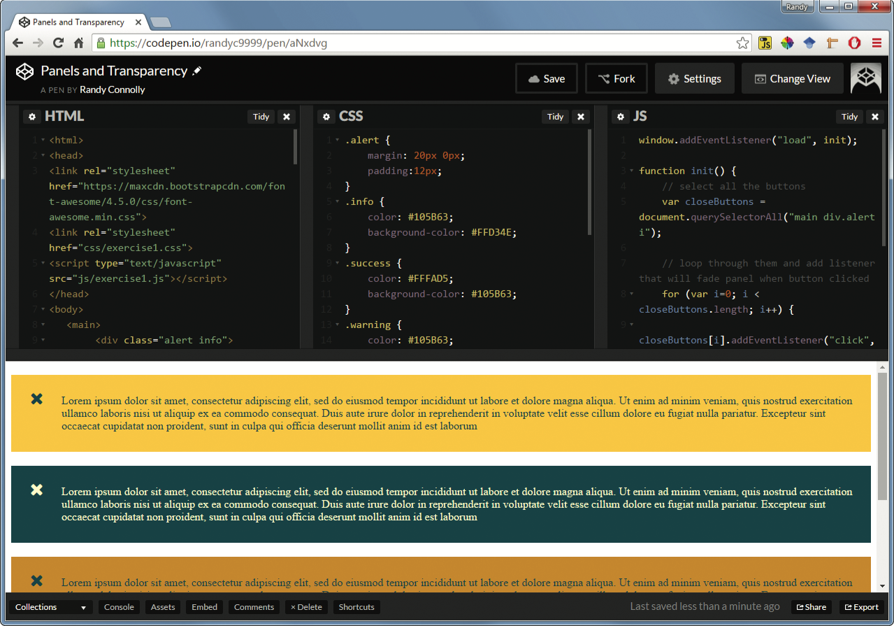
Tools Insight
Code Playgrounds

Slide 53
Chapter 3
1
What Is HTML and Where Did It Come from?
2
HTML Syntax
3
Semantic Markup
4
Structure of HTML Documents
5
Quick Tour of HTML Elements
6
HTML5 Semantic Structure Elements
7
Summary

Slide 54
Summary
Key Terms
absolute referencing
accessibility
ancestors
body
Cascading Style Sheets
(CSS)
character entity
description lists
descendants
directory
document outline
Document Object Model
Document Type
Definition
empty element
folder
head
HTML attribute
HTML validators
inline HTML elements
maintainability
markup
markup language
ordered lists
pathname
polyfill
quirks mode
Recommendations
relative referencing
root element
root reference
schemas
search engine optimization
semantic HTML
specifications
standards mode
syndication
syntax errors
tags
unordered lists
UTF-8
WHATWG
W3C
XHTML 1.0 Strict
XHTML 1.0 Transitional

Slide 55
Questions

